Slide 1



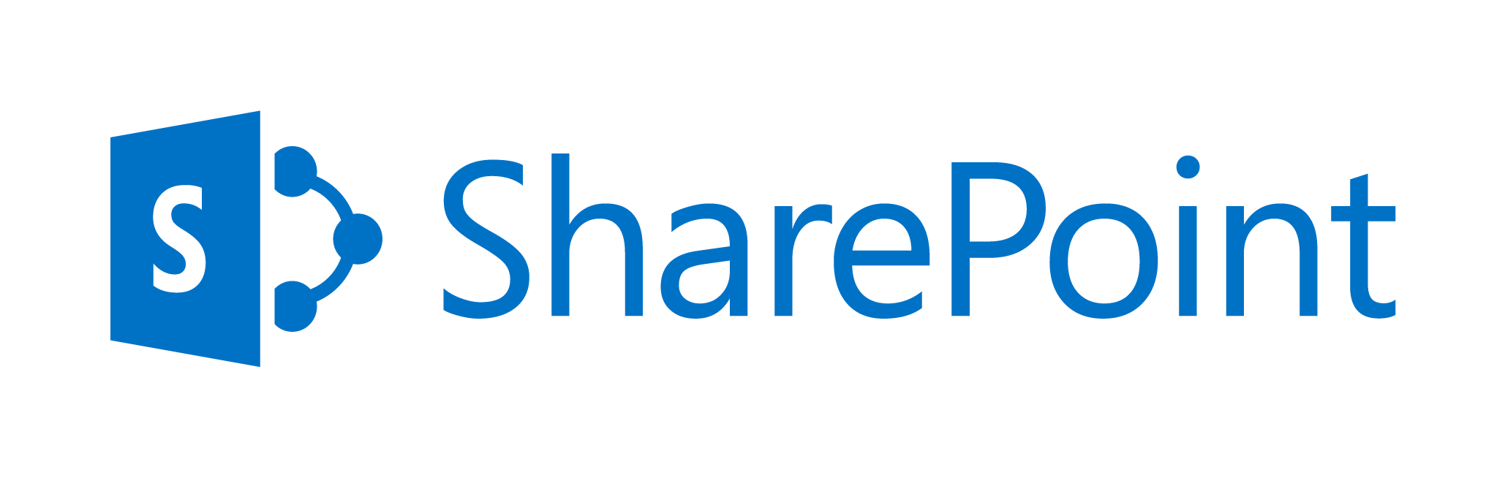
Office 365 and SharePoint Administration with PowerShell, CMD and PnP Features
+
=
Gokan Ozcifci (MVP, RL)
Gilles Pommier (MVP)
Notes:
This slide is mandatory. Please do not remove.

Slide 2





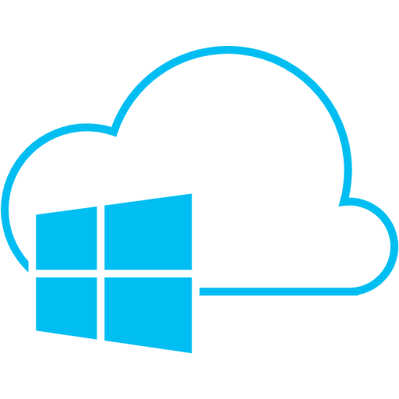
Hi. I’m Gokan.
Brussels, BELGIUM
neoxy.be
Most Valuable Professional
Microsoft Regional Lead
@xGokan
http://gokan.ms

Slide 3






Hello I‘m Gilles
Montpellier, FRANCE
smartview.fr
Office365 MVP
Community Member
gilles.pommier@smartview.fr
http://www.smartview.fr

Slide 4
Notes:
This slide is mandatory. Please do not remove and try to use it during Q&A at the end of your session. Thank you!

Slide 5

Find this session and all others here: https://docs.com/gokanozcifci

Slide 6
What about this session?
Introduction to SharePoint Server.
Using PowerShell with SharePoint.
Tips and Tricks for “Powers Hell”
Managing Office 365 with PowerShell
OfficeDev/PnP-PowerShell
DevOps with PowerShell in Office 365.

Slide 7

Introduction
PowerShell for On-Premises

Slide 8
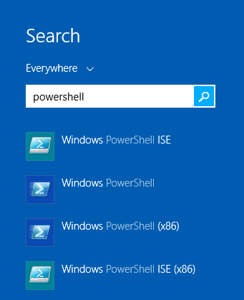

Why PowerShell
No Compiling.
No Packaging.
No Visual Studio.
Not only for developers.

Slide 9
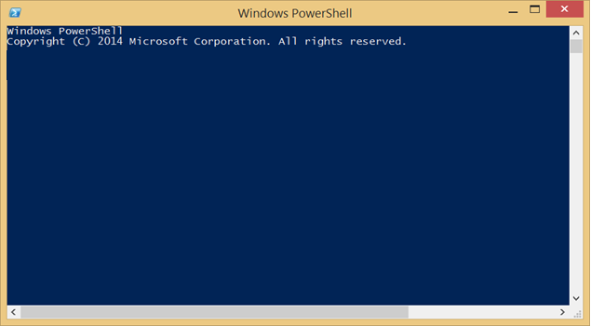
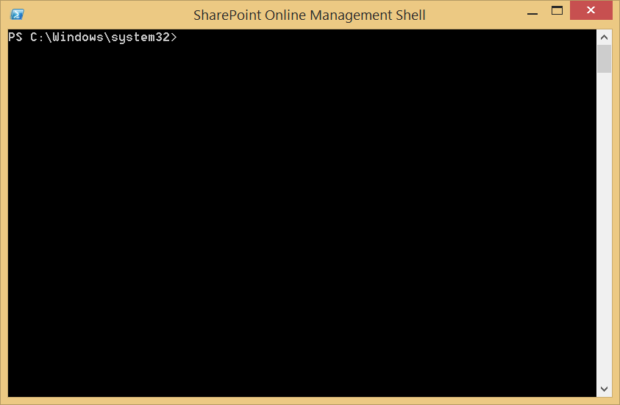
POSH vs the SharePoint Mgmt Shells

Slide 10
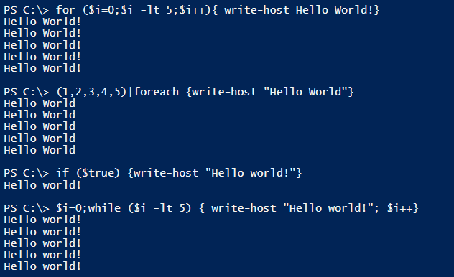
There is no one rule for all.

Slide 11
PowerShell in SharePoint 2013
PowerShell 3.0
300 new cmdlets. 30+ cmdlets removed
Start PowerShell and run
Add-PSSnapin Microsoft.SharePoint.PowerShell
SharePoint 2013 Management Shell
Use PowerShell ISE

Slide 12
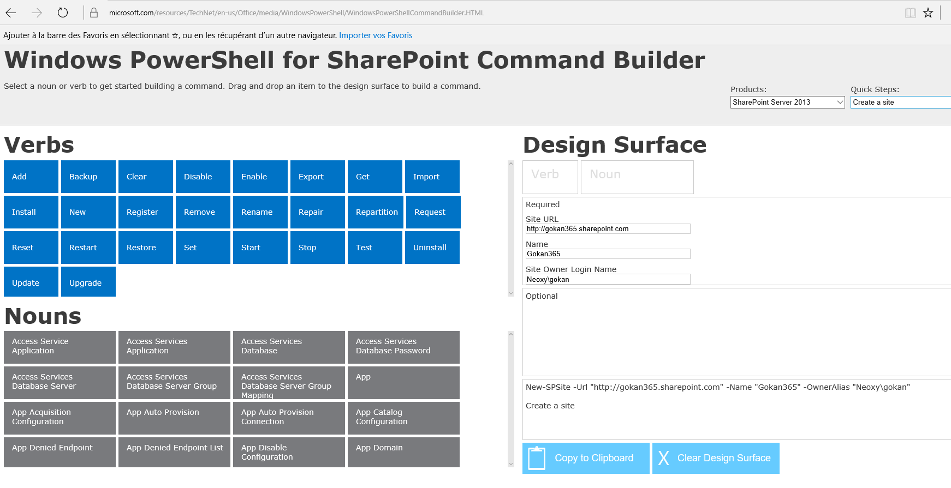
PowerShell Command Builder
http://www.microsoft.com/resources/TechNet/en-us/Office/media/WindowsPowerShell/WindowsPowerShellCommandBuilder.HTML

Slide 13
PowerShell for On-Premises tricks

Slide 14
Get # of clientconn on #SharePoint WFE
Get-Counter -Counter 'web service(_total)\current connections' -ComputerName servername

Slide 15
Find lost application pool passwords
\system32\inetsrv\appcmd.exe list apppool “SharePoint - 80" /text:*

Slide 16
Restore accidentally deleted sites
Get-SPDeletedSite (gives you the ID)
Restore-SPDeletedSite (restores it)

Slide 17
How did that ever work?
Get-History | Select –Expand CommandLine | Out-File script.ps1

Slide 18
Sound after a long script..
[console]::beep(440,500)
[console]::beep(440,500)
[console]::beep(440,500)
[console]::beep(349,350)
[console]::beep(523,150)
[console]::beep(440,500)
[console]::beep(349,350)
[console]::beep(523,150)
[console]::beep(440,1000)
[console]::beep(659,500)
[console]::beep(659,500)
[console]::beep(659,500)
[console]::beep(698,350)
[console]::beep(523,150)
[console]::beep(415,500)
[console]::beep(349,350)
[console]::beep(523,150)
[console]::beep(440,1000)

Slide 19
Cortana for PowerShell
Add-Type -AssemblyName System.Speech
$synth = New-Object -TypeName System.Speech.Synthesis.SpeechSynthesizer
$synth.Speak('Hi Gokan. SharePoint ROCKS!')

Slide 20
Find a new job, through PowerShell ☺
stop-computer -force | Get-ADComputer -Filter *

Slide 21

Office365
PowerShell Online

Slide 22
Multiple solutions to manage Office 365
Office 365 Management APIs
Office 365 Management APIs
Programmatic access
Innovate on top
PowerShell
PowerShell for Office 365
Automate and customize
Advanced functions
Office 365 Admin Center
Office 365 Admin Center
Out-of-the-box solution
Simple but extensible
Office 365 Admin App
Office 365 Admin App
On-the-go solution
Contextual

Slide 23
Why Office 365 PowerShell ?
Additional information that you cannot see with the Office 365 Admin center
Features that you can only configure by using Office 365 PowerShell
bulk operations
Datas migration
Provisionning
Easy to print or save data
Manage across server products

Slide 24


What do you need ?
An Office 365 tenant
Administrator privileges on your Office 365 tenant
Administrator privileges on your machine running PowerShell
Administration modules
Microsoft Online Services Sign-in Assistant
Azure Active Directory Module
SharePoint Online Module
On-Premises
Farm Administrator

Slide 25

Getting started
http://powershell.office.com/
Sets of samples, scenarios, guides, …

Slide 26



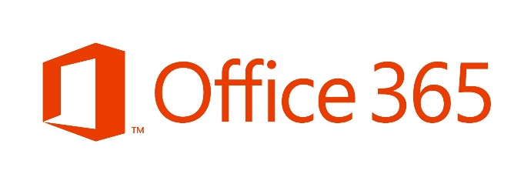
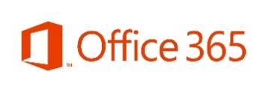

Office 365 Services with PowerShell
# Exchange Online
$exchSession = New-PSSession `
–ConfigurationName Microsoft.Exchange `
-ConnectionUri https://ps.outlook.com/powershell `
-Credential $c `
-Authentication Basic `
–AllowRedirection
Import-PSSession $exchSession –AllowClobber
# Skype for Business (aka Lync Online)
Import-Module LyncOnlineConnector
$skypeSession = New-CsOnlineSession -Credential $c
Import-PSSession $skypeSession –AllowClobber
Module Azure Active Directory (MSOnline)
# SharePoint
Import-Module Microsoft.Online.Sharepoint.PowerShell
Connect-SPOService -Url https://tenant-admin.sharepoint.com/ -Credential $c

Slide 27
Demo 1a
Connect to Office 365 with PowerShell

Slide 28
PowerShell cmdlets
Number of PowerShell cmdlets :
On-premises compared to Online
905 vs 32
https://technet.microsoft.com/en-us/library/fp161388.aspx

Slide 29
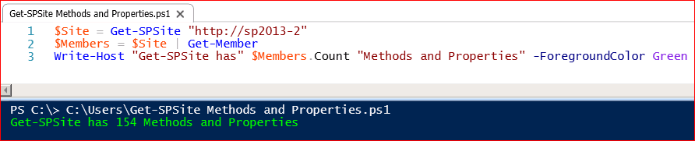
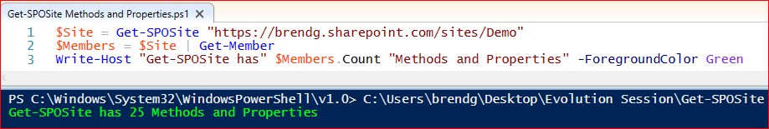
SharePoint Online vs. On Premises Cmdlets
“I will only need to make minor changes to my scripts”
Wrong!!! – Cmdlets aren’t functionally equivalent
Have different Methods and Properties
In some cases behave differently

Slide 30
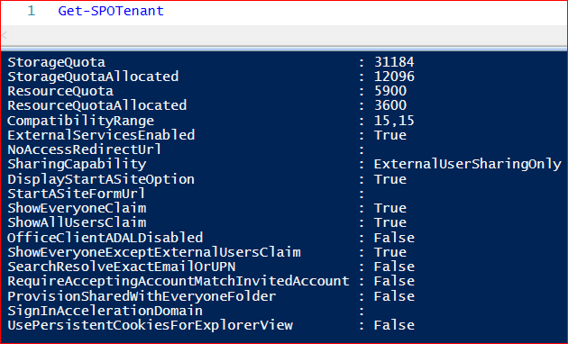
SharePoint Online vs. On Premises Cmdlets
Another example:
Get-SPSite returns all Site Collections
Get-SPOSite returns all Site Collections except My Sites
Get/Set-SPOTenant can be used to retrieve and update Tenant level settings
Sometimes the only option!

Slide 31
Demo 1b
Some PowerShell Office 365 use cases
Exchange Online
PowerBI (https://github.com/DevScope/powerbi-powershell-modules)

Slide 32

OfficeDev/PnP-PowerShell

Slide 33
Click deployments
Much effort
Time consuming
An Unexpected Error has occurred ☺
Difficult to repeat and reproduce
Not everything is exposed to the User Interface

Slide 34
Command line app
Requires code / development skills
More Difficult to adjust to changing requirements
Single use case

Slide 35
PowerShell
Simple to write
Commonly known
Many blog posts
Easy to adjust scripts to changing requirements

Slide 36
Office Dev PnP Cmdlets
Open Source
Community effort
Free

Slide 37
Old School PowerShell
Add-Type –Path 'C:\Program Files\Common Files\Microsoft Shared\Web Server Extensions\16\ISAPI\Microsoft.SharePoint.Client.Runtime.dll’
$url=https://gokan.sharepoint.com/sites/PnP
$O365Credential= new-object Microsoft.SharePoint.Client.SharePointOnlineCredentials($creds.UserName,$creds.Password)
$ctx= new-object Microsoft.SharePoint.Client.ClientContext($url)
$ctx.Credentials = $O365Credential
…
$fieldXml="<Field Type=""Choice"" Name=""SPSLocation"" DisplayName=""Location"" ID=""{ba27f512-27bc-4d07-bdd4-2ee61bc5bcb4}"" Group=""Demo Group"“ Required=""TRUE""><CHOICES><CHOICE>Brussels</CHOICE><CHOICE>Belgium</CHOICE><CHOICE>Paris</CHOICE></CHOICES></Field>
$field= $list.Fields.AddFieldAsXml ($fieldXml, $true, [Microsoft.SharePoint.Client.AddFieldOptions]::AddFieldToDefaultView);
$ctx.Load($list);
$ctx.ExecuteQuery();

Slide 38
‘New School’ PowerShell
Connect-SPOnline -Url https://gokan.sharepoint.com/sites/PnP -Credentials GOKAN
New-SPOList –Title "Demo list" –Template GenericList -Url lists/demo
Add-SPOField –List "Demo list" `
-DisplayName "Location" `
-InternalName "SPSLocation" `
-Type Choice `
-Group "Demo Group" `
-AddToDefaultView `
-Choices "Brussels", "Belgium", "Paris"

Slide 39
Adding and setting a new theme to a site
Connect-SPOnline –Url https://tenant.sharepoint.com
Add-SPOFile –Path C:\theme.spcolor –Folder "_catalogs/theme/15"
Add-SPOFile –Path C:\image.jpg –Folder "SiteAssets"
Set-SPOTheme `
–ColorPaletteUrl "/_catalogs/theme/15/theme.spcolor" `
-BackgroundImageUrl "/SiteAssets/image.jpg"

Slide 40

PowerShell and SharePoint : identify the target

Slide 41

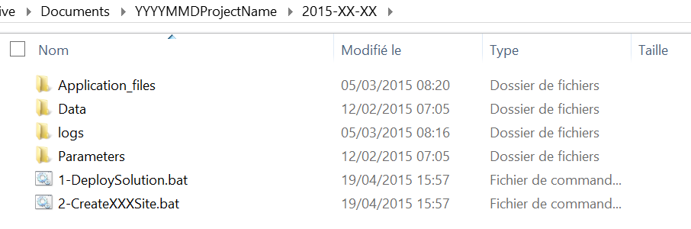
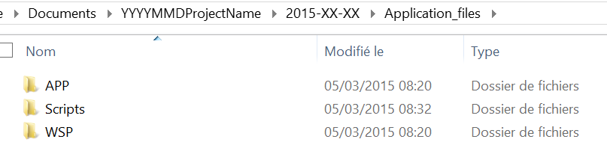
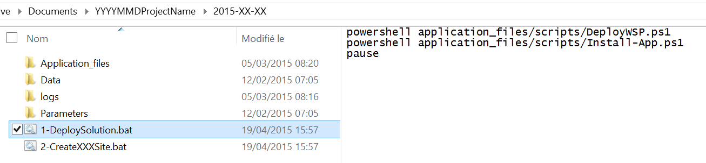
Rule #1 : organize your scripts
Project deployment Folder
Application Files Folder
Launcher

Slide 42
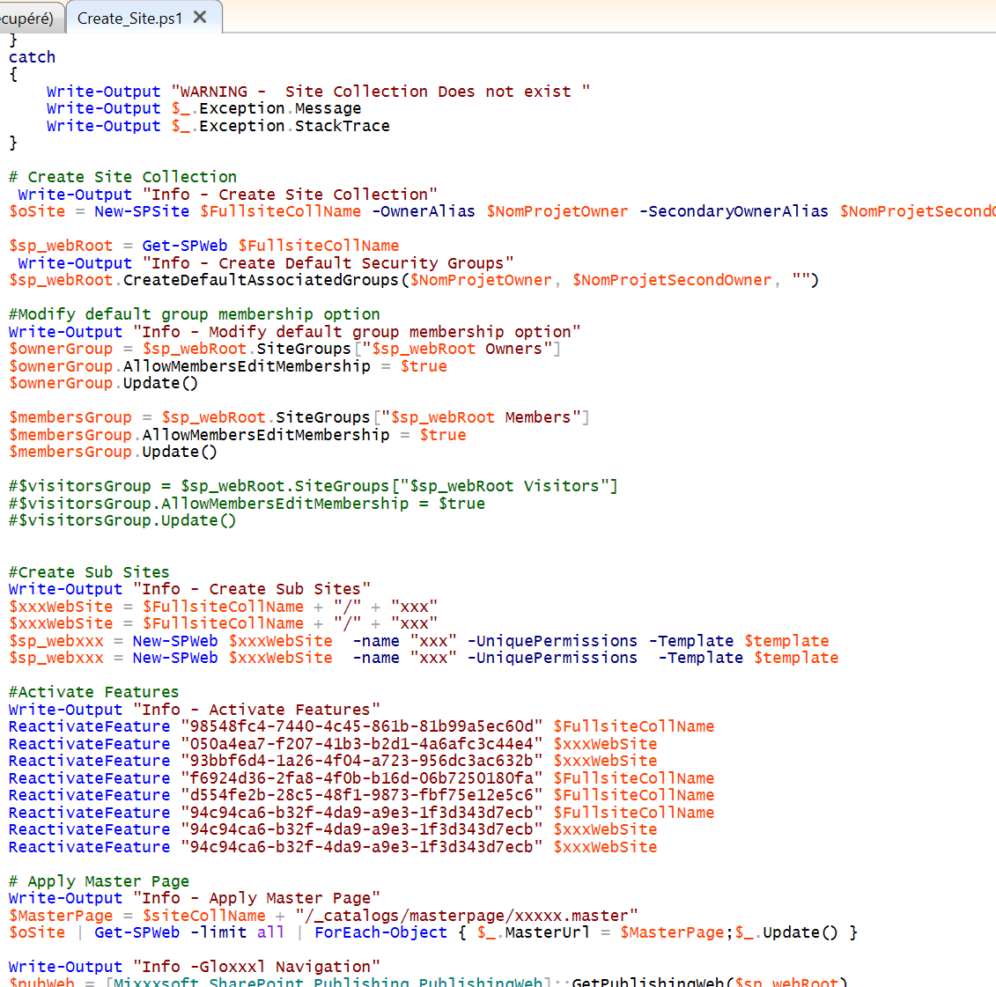
Rule #2 - Think “SharePoint”
SPSite
SPWeb
SPList
SPListItem

Slide 43

Office PnP-PowerShell : unlock the power

Slide 44

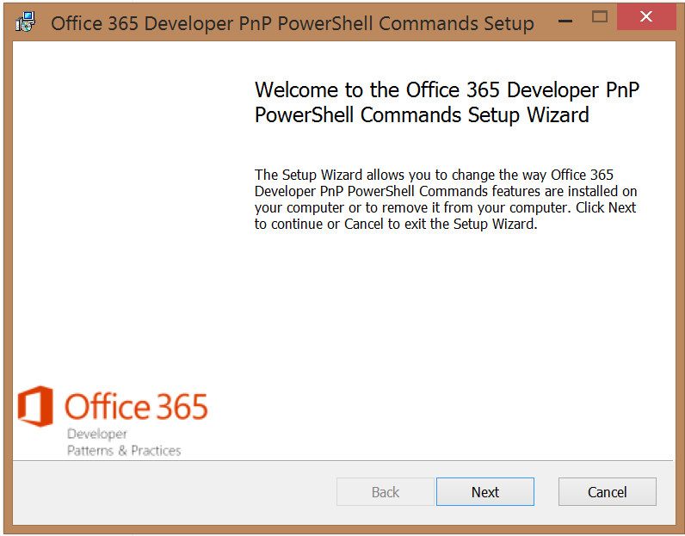
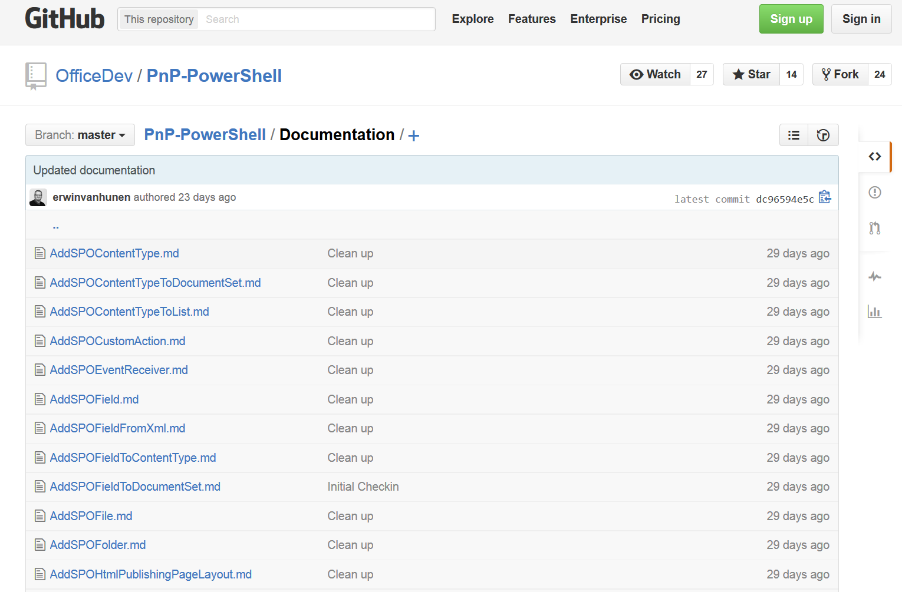
Office PnP-PowerShell Commands : Where ?
https://github.com/OfficeDev/PnP-PowerShell

Slide 45

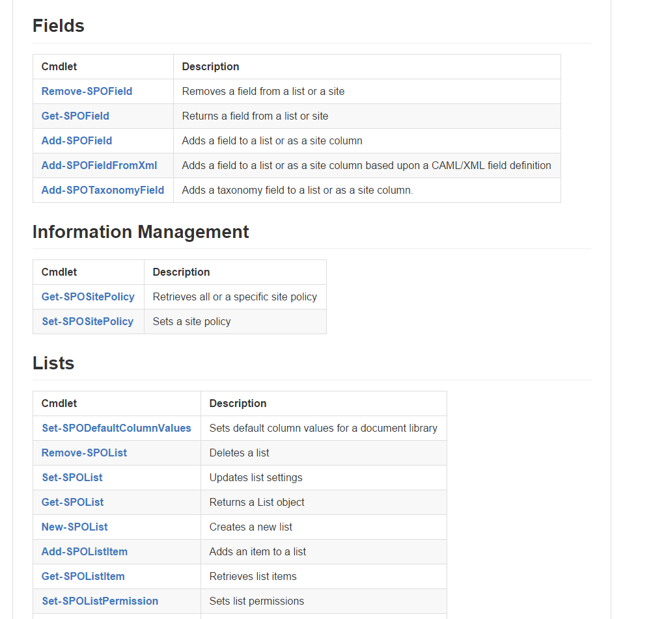
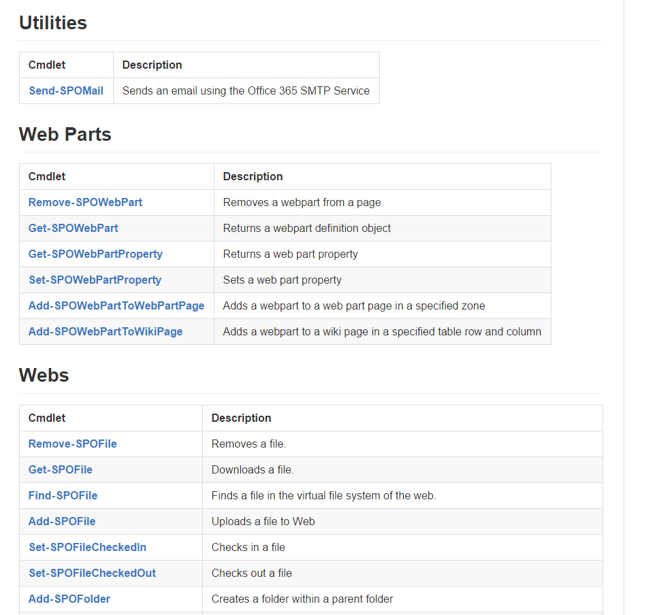
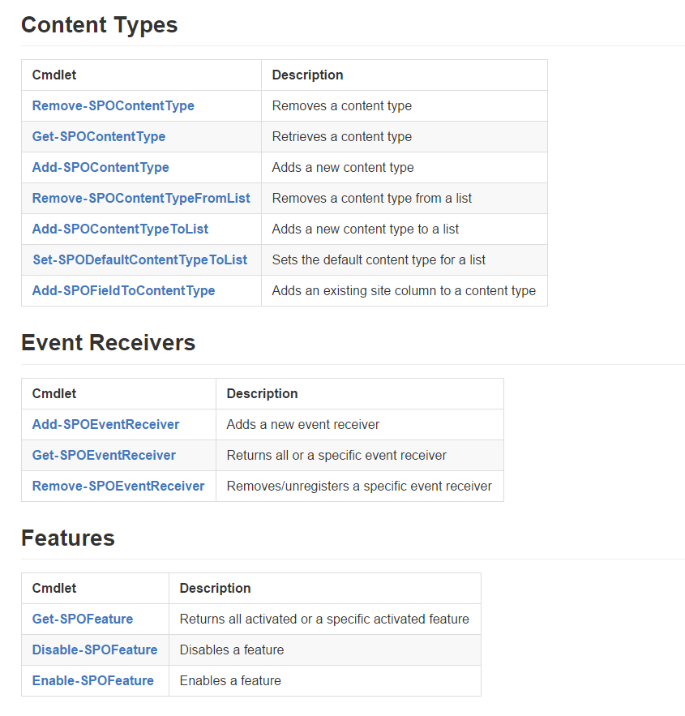
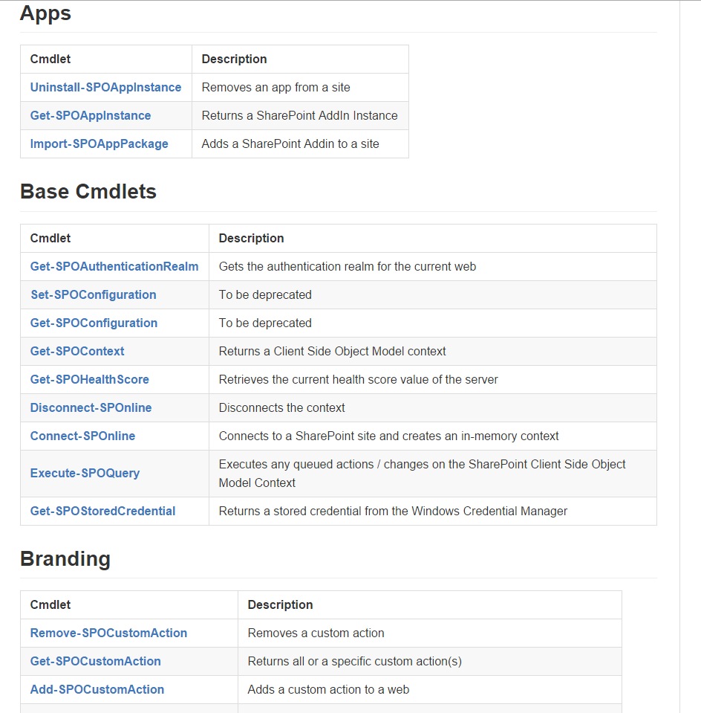
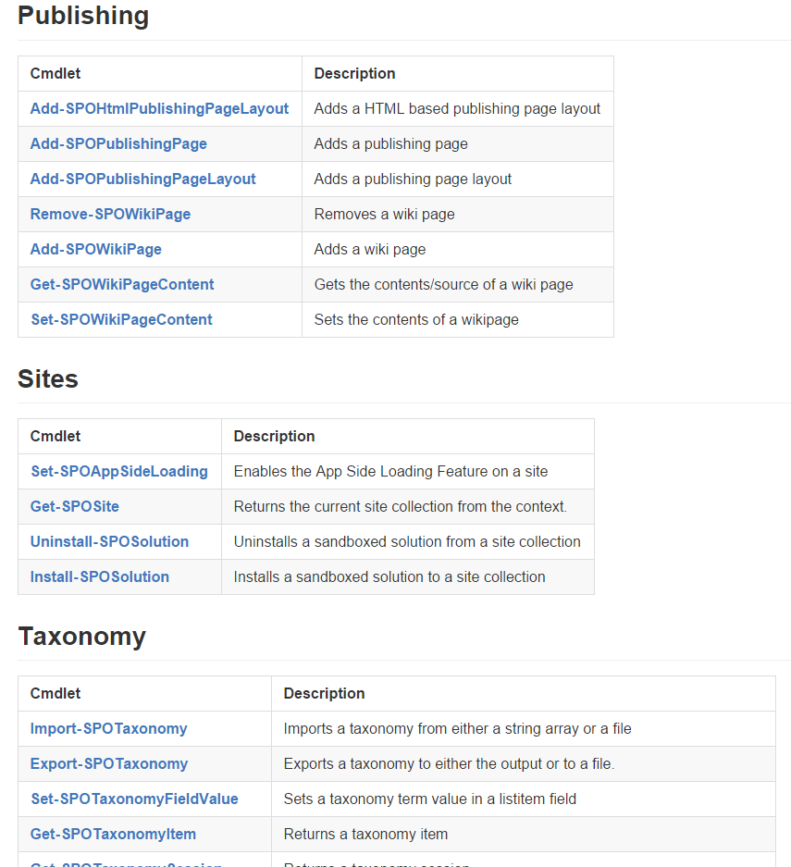
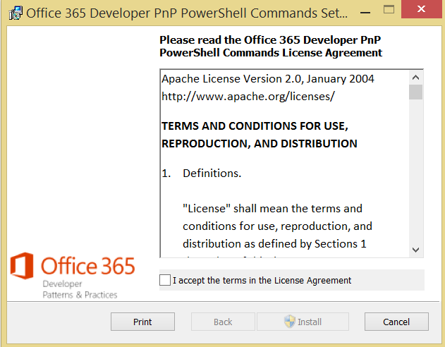
PnP-PowerShell commands : what?

Slide 46
Demo
Office Dev PnP – PowerShell Commands

Slide 47
DevOps with PowerShell in Office 365

Slide 48
First… What is DevOps ?
DevOps (a clipped compound of “development” and “operations”) is a software development method that stresses communication, collaboration, integration, automation and measurement of cooperation between software developers and other information-technology (IT) professionals.

Slide 49
What it means to me…
Automate everything you can (developers can help!)
Ensure that every configuration can be replicated anywhere at any time
Gain a maximum of control over your deployments
Are you scared of your users ?

Slide 50
In the Office 365 world, it means…
Every artifact that is created needs to be scripted or automatically provisioned
Users
Mailboxes
SharePoint
Sites
Columns
Content Types
Lists
…
…

Slide 51

Questions?
gilles.Pommier@smartview.fr
gokan@neoxy.be
© 2015 Neoxy SPRL-S, tous droits réservés
Toute reproduction interdite sans l'autorisation de l'auteur.

Slide 52
Thank you!
gilles.Pommier@smartview.fr
gokan@neoxy.be
© 2015 Neoxy SPRL-S, tous droits réservés
Toute reproduction interdite sans l'autorisation de l'auteur.

